Slide 1
intel’s makers community ESP32 for advanced makers
Gil Tal.
Sep 2022

Slide 3
Course agenda:
What is the ESP32
Main features
The whole family
Some cool projects
Communication options
Dual CPU – Multi Tasks
Queues
File System
OTA
Good to know

Slide 4
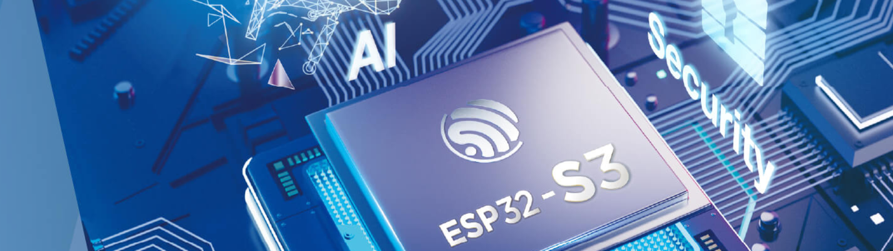
What is an ESP32?
Highly advanced micro controller
Targeted at IOT
Supported by Arduino SDK
Low cost (2.5$ - 4$)

Slide 5

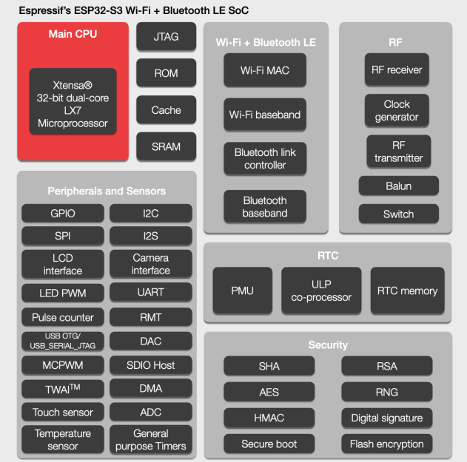
Main features …
Dual-core XTensa LX7 @ 240 MHz
Wi-Fi + Bluetooth 5 (LE)
Rich Set of IO Peripherals
SPI, I2C, I2S, Camera, LCD, 45 IOs, SD
Ultra-low-power (ULP) core
FreeRTOS OS
Multi tasks, Queues
AI Acceleration Support
OTA
File System + EEPROM
384KB SRAM , up to 8MB SPI-RAM, up to 32MB flash memory (Programs + file system)

Slide 6
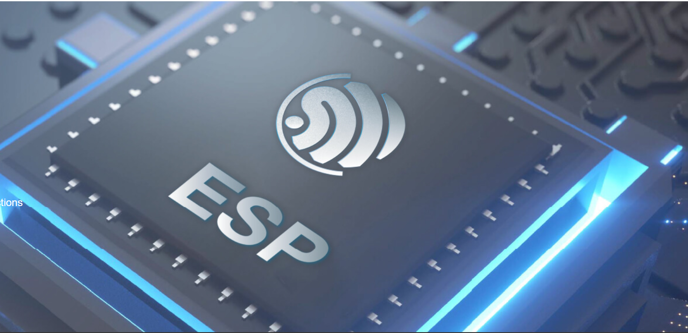
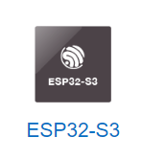
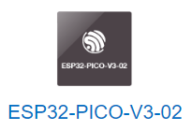
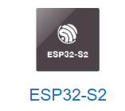
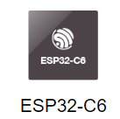
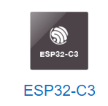
The whole family

Slide 7

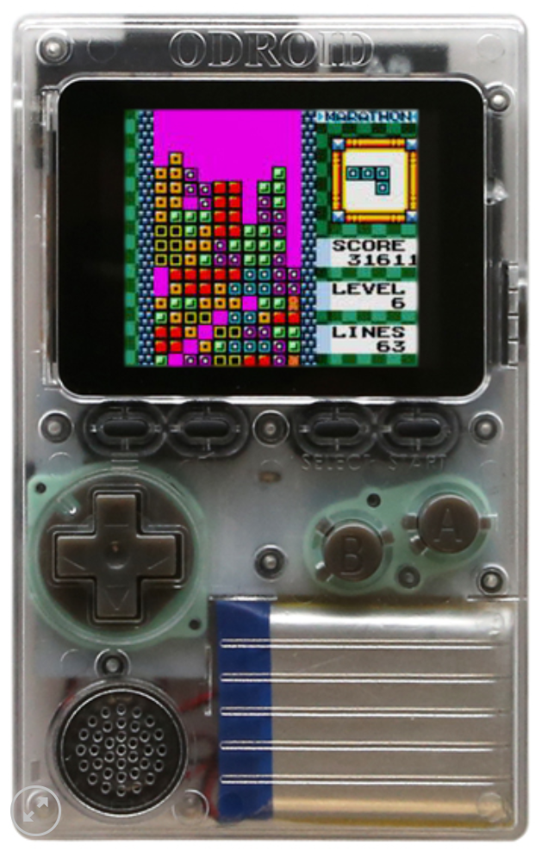
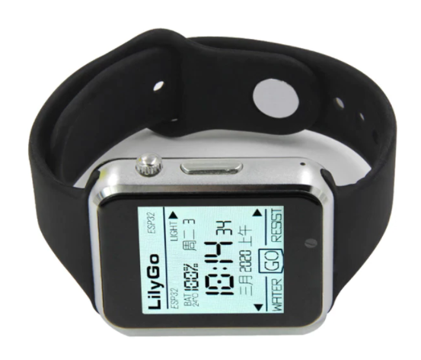
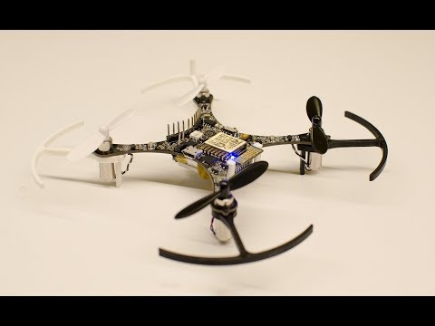
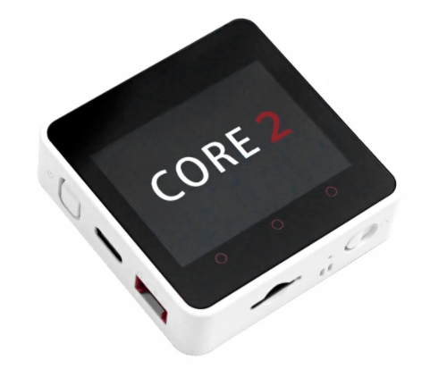
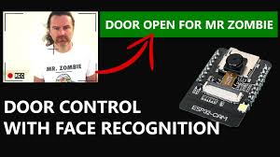
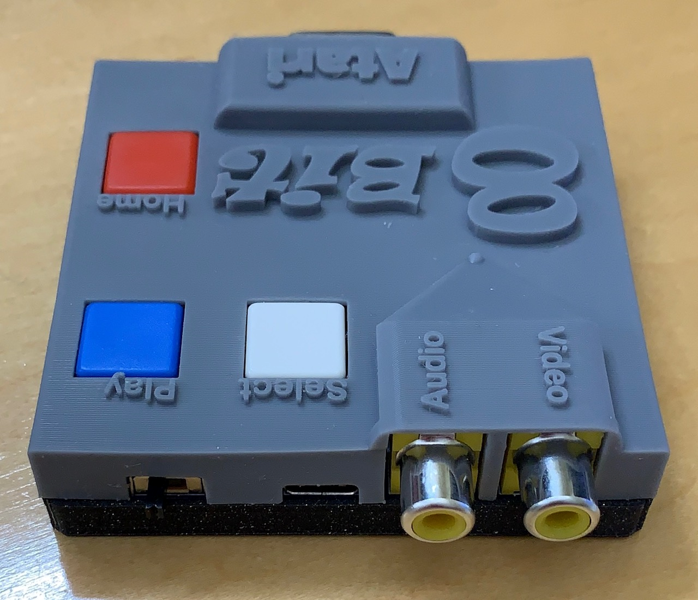
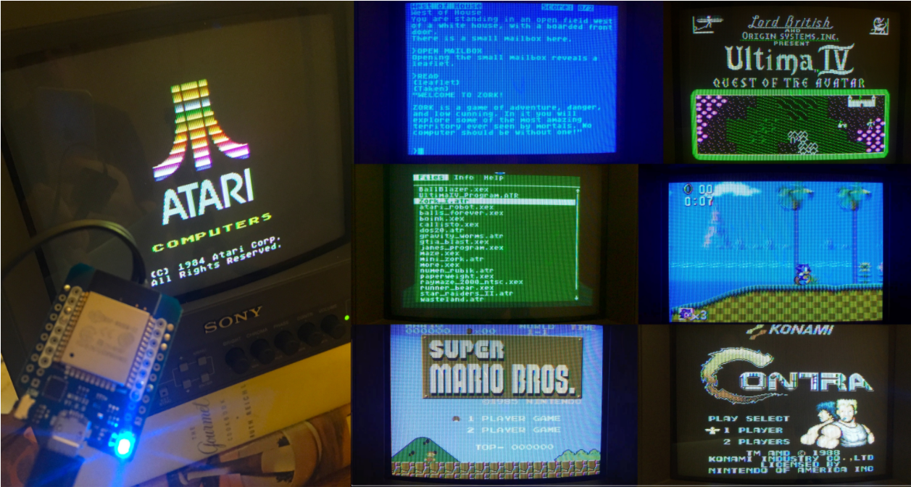
Some cool projects

Slide 8
Communication options
Legacy IOs (Digital and Analog)
WiFi
Using Web Server (Access via Phone, Tablet and any devices with a web browser)
ESPnow
Over cloud services
MQTT
Bluetooth
LoRa

Slide 9
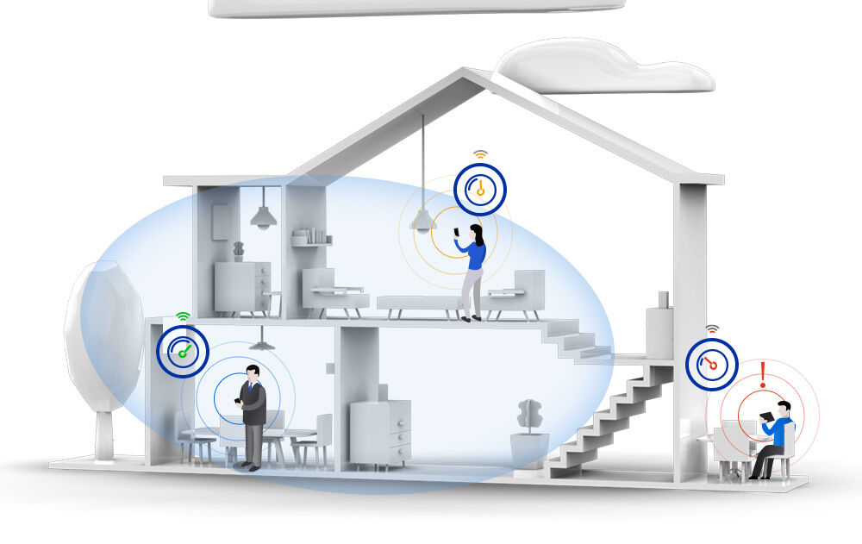
Wi-fi basics
Wi-Fi basics:
Family of wireless networking technologies
IEEE 802.11 family of standards
Used for local area networking of devices and Internet access
20-150 meters range
Standard defines 16 channels for communication
Enables multiple access points at the same physical location

Slide 10
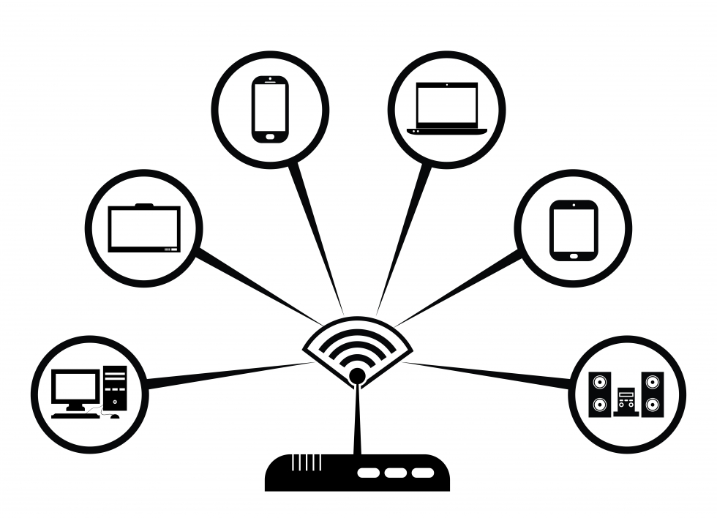
Communication options
AP – Access point
STA – Station
An end point device
Enable the creation of a local Wi-Fi network
We connect to an access point
With or without access to the internet
Uses a specific channel which can be modified while operating
Has limitation for number of connected devices
Has a name and an optional password
Can use an encrypted communication protocol
Connects to an AP
While searching for an AP needs to scan different channels until found
Station name and password can be saved on EEPROM, SPIFFS or SDCARD
End Point device
AP

Slide 11
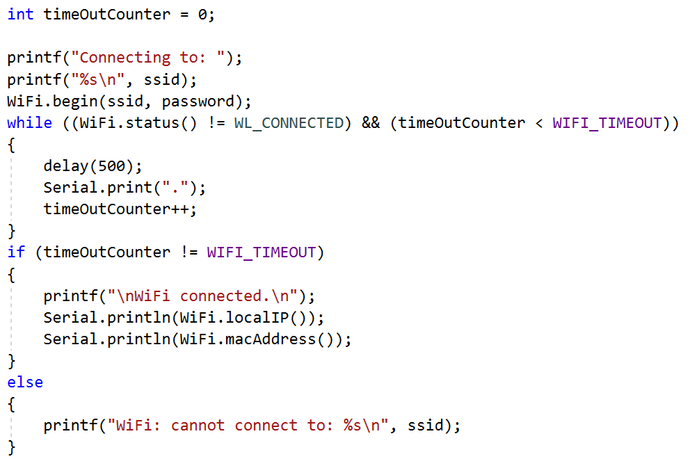
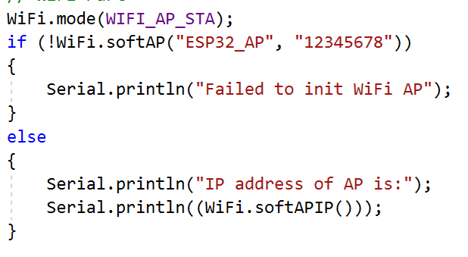
Wi-fi basics: our esp32
Runs full network stack
Can function as:
AP
By default, enables up to 4 users
STA
Both*

Slide 12
HTML
Hyper Text Markup Language
Is the standard markup language for documents designed to be displayed in a web browser
It can be assisted by technologies such as Cascading Style Sheets (CSS) and scripting languages such as JavaScript
https://www.w3schools.com/ - great site for learning and designing web pages

Slide 13
webserver
Web pages are hosted on a webserver
Most commonly written in HTML5 + JAVA script
There are various HTML5 emulators out there
Has a specific IP address (192.168.14.1 for example)
Is a passive device
We need a browser to access it
Browser is executing the HTML5 code
The communication protocol is HTTP
There are large number of hosting providers
IP address can be replaced by a name
DNS server translates the name to the specific IP address
ESP32 can run a webserver! ☺

Slide 14
Webserver – what can we do with it?
Have
a nice GUI to communicate with the ESP32 using a browser
Control
IOs
Get
information from our ESP32
Such as temperature, humidity depending on what we connected
Send
data to the ESP32
Files
Raw data

Slide 15
Webserver – workflow
We need to initialize:
WiFi
Webserver
Prepare the HTML for the pages
Handle the client which interacts with the browser
Process the incoming data from the browser to perform actions on the ESP

Slide 16
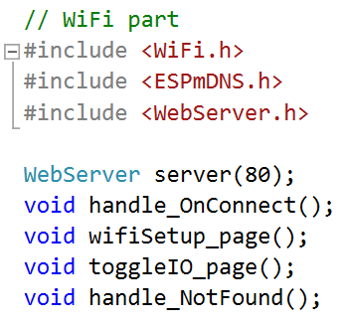
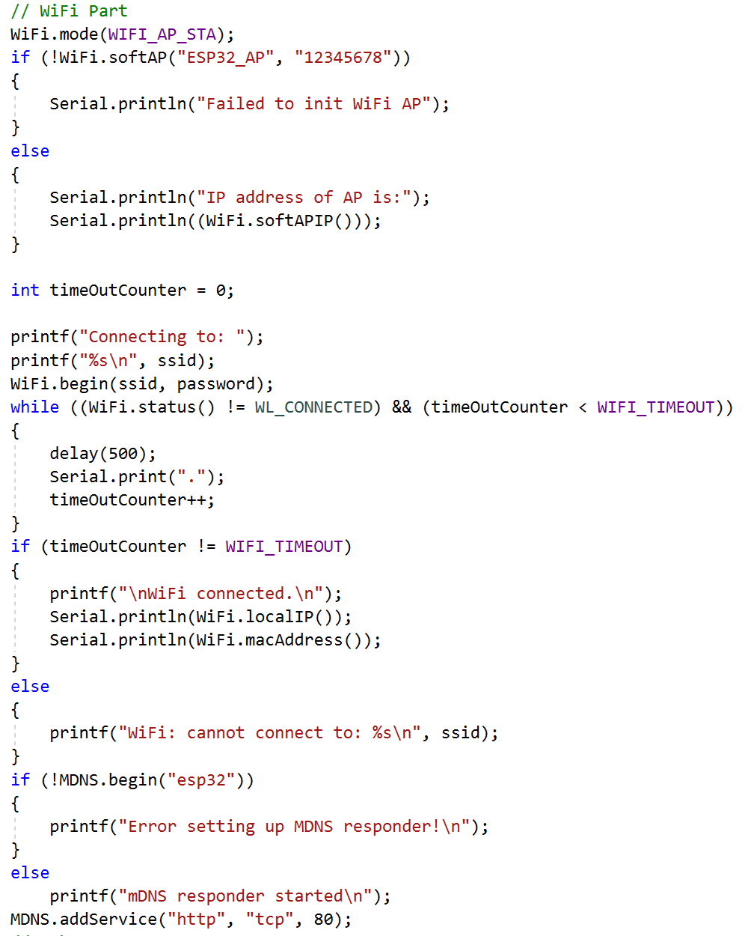
Webserver – Init code

Slide 17
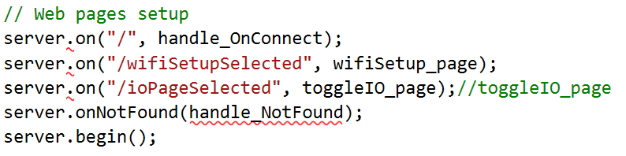
Webserver – INIT code

Slide 18
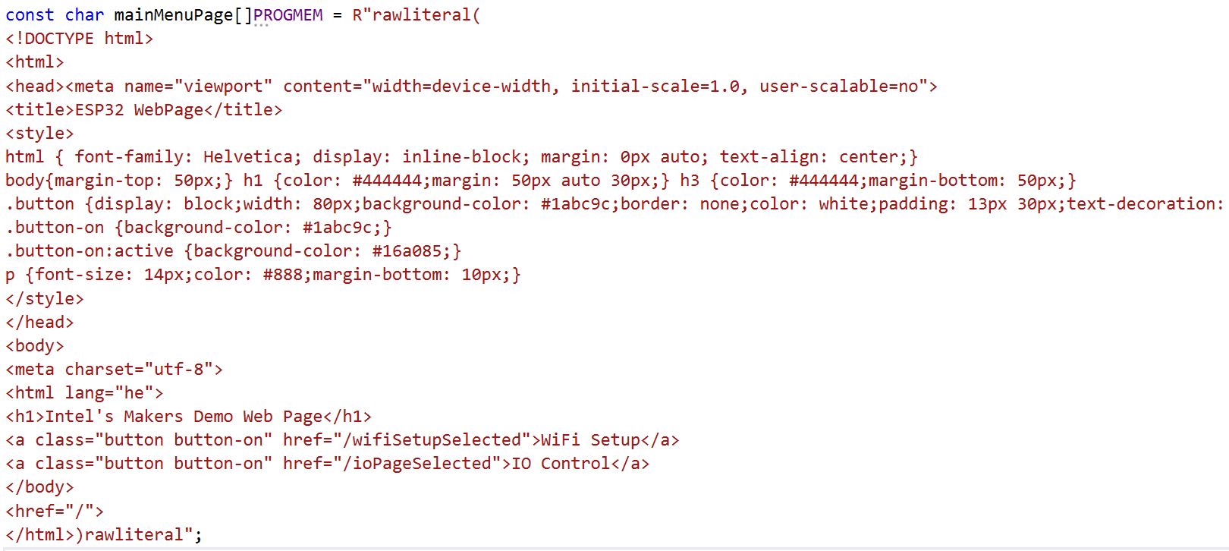
Webserver – html data

Slide 19
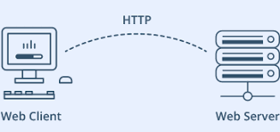
Webserver – html data
For static data with pre-defined start conditions:
const char mainMenuPage[]PROGMEM = R"rawliteral(
HTML Data
)rawliteral";
For dynamic data with interactive page we need to use String and build the page in real time!

Slide 20
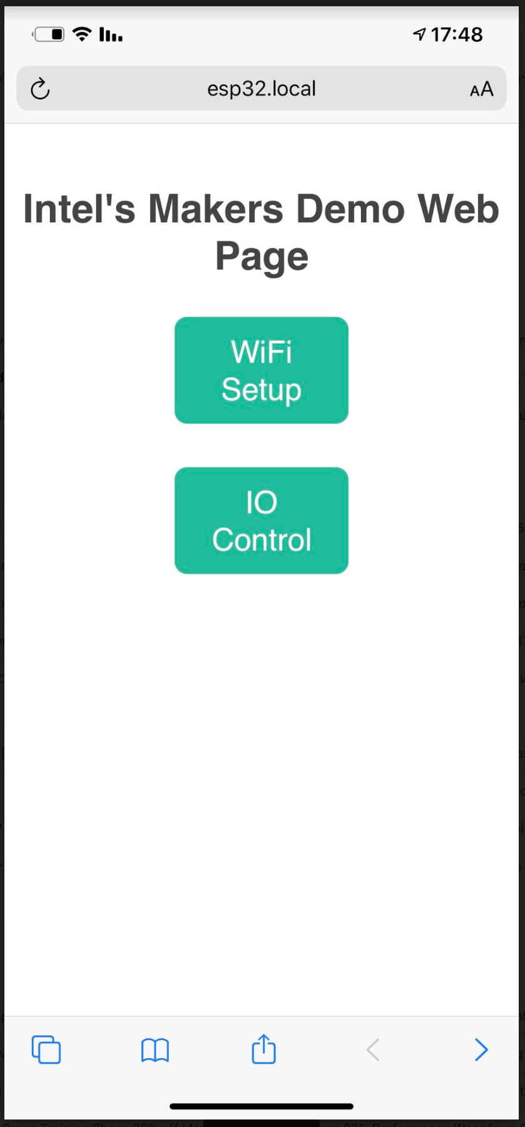
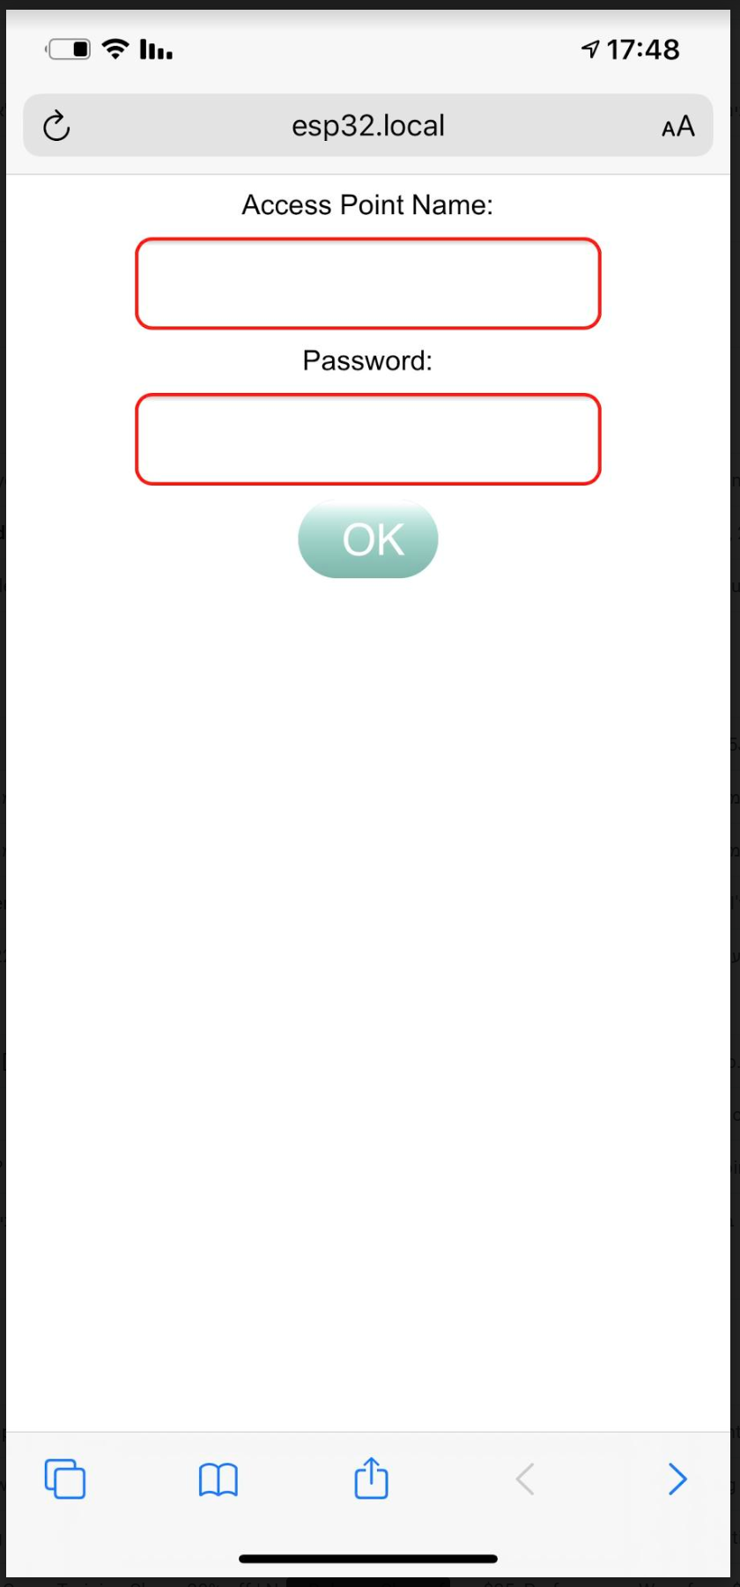
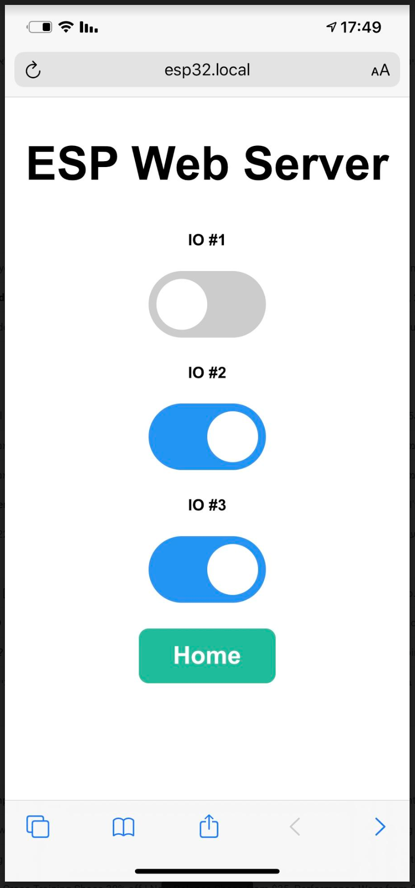
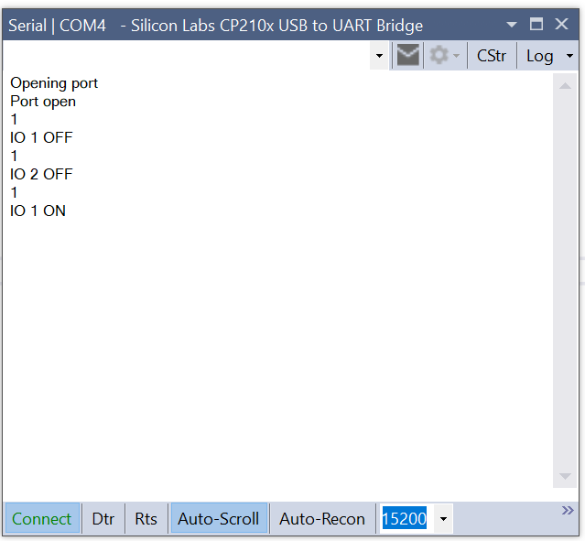
How does it looks like…

Slide 21
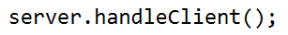
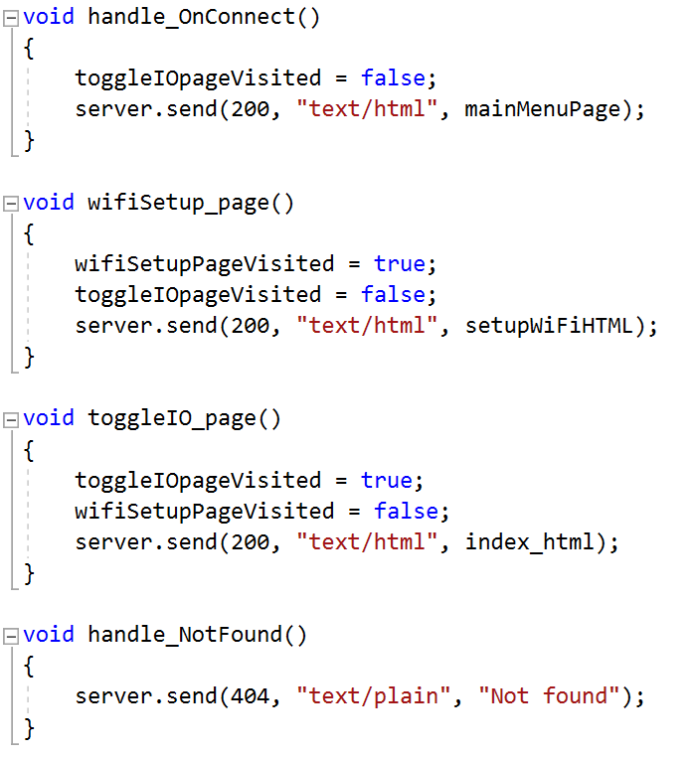
Webserver – handle the client

Slide 22
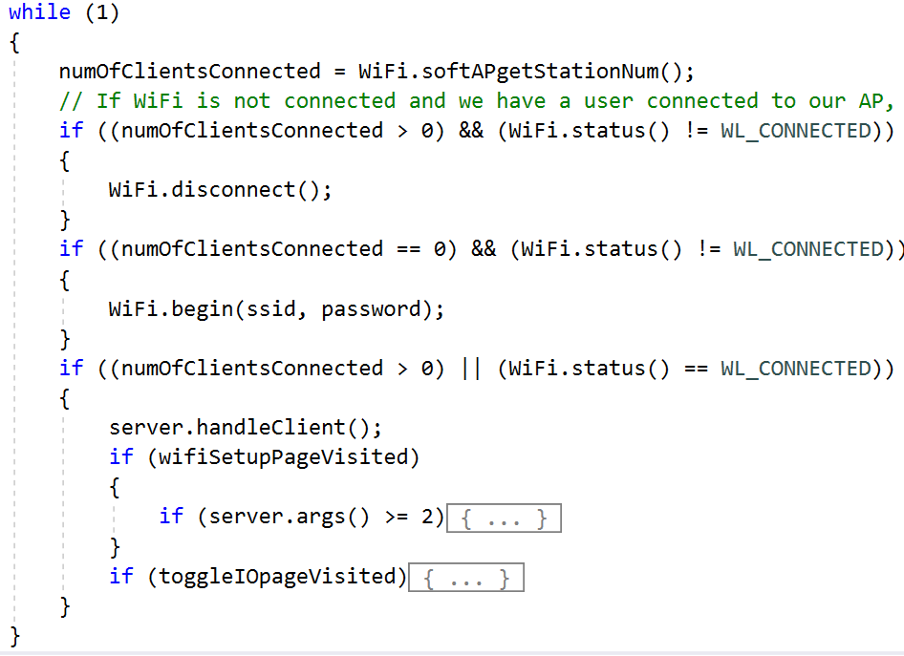
Webserver – processing incoming data

Slide 23
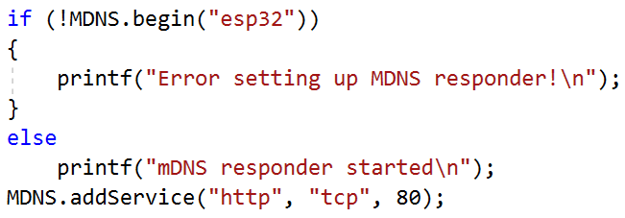
Multicast DNS
Domain Name System
MDNS – Is a zero-configuration service
Enables usage of names instead of IP address
Our ESP32 runs Multicast DNS (MDNS)
Windows and Apple devices can work with MDNS
Sadly Android does not ☹
Usage:
http://esp32.local/
No MDNS support - http://192.168.14.1/ (just an example IP)

Slide 24
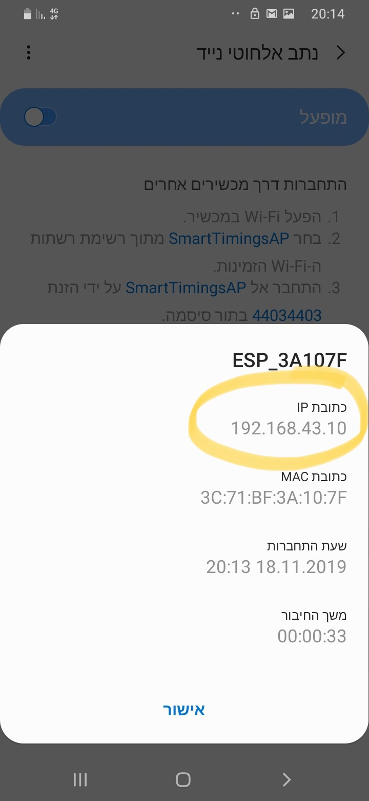
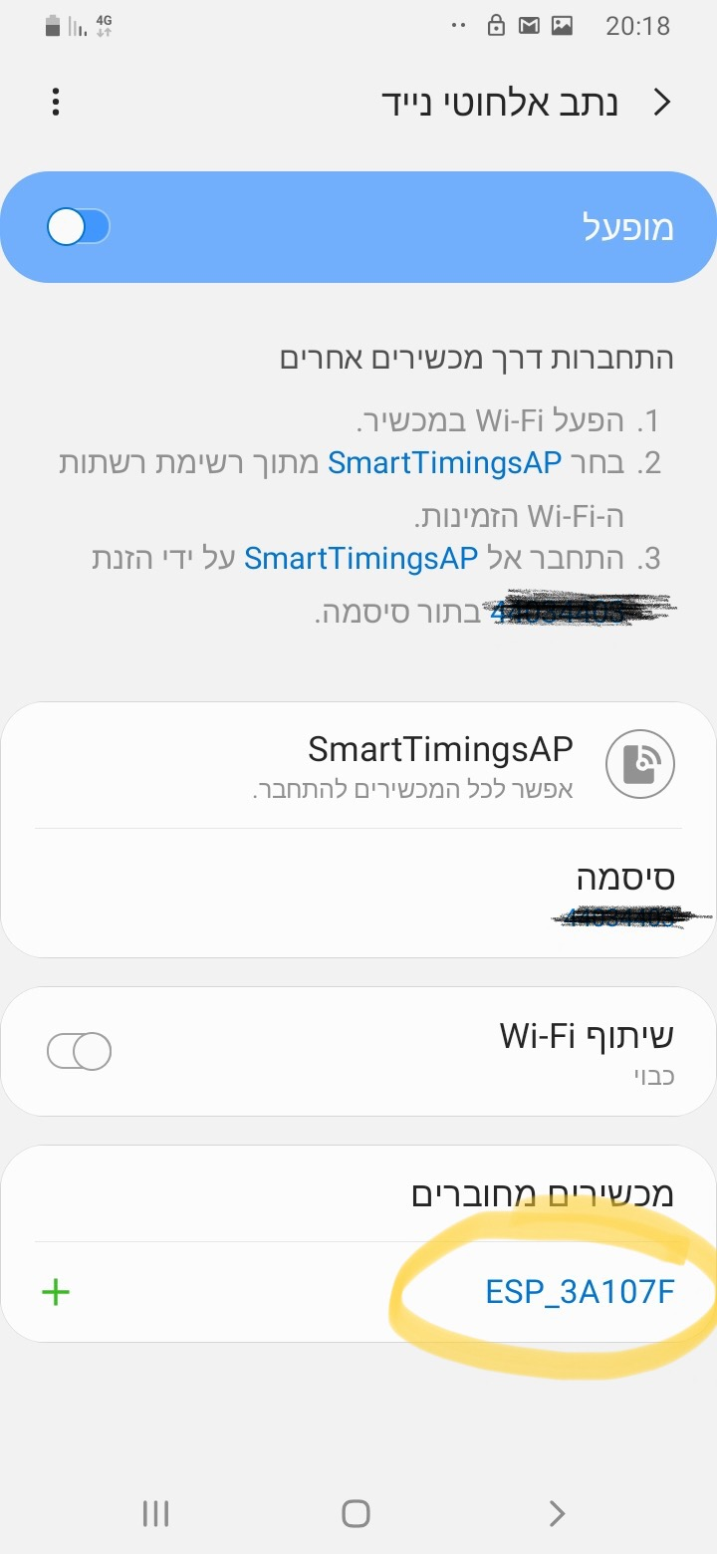
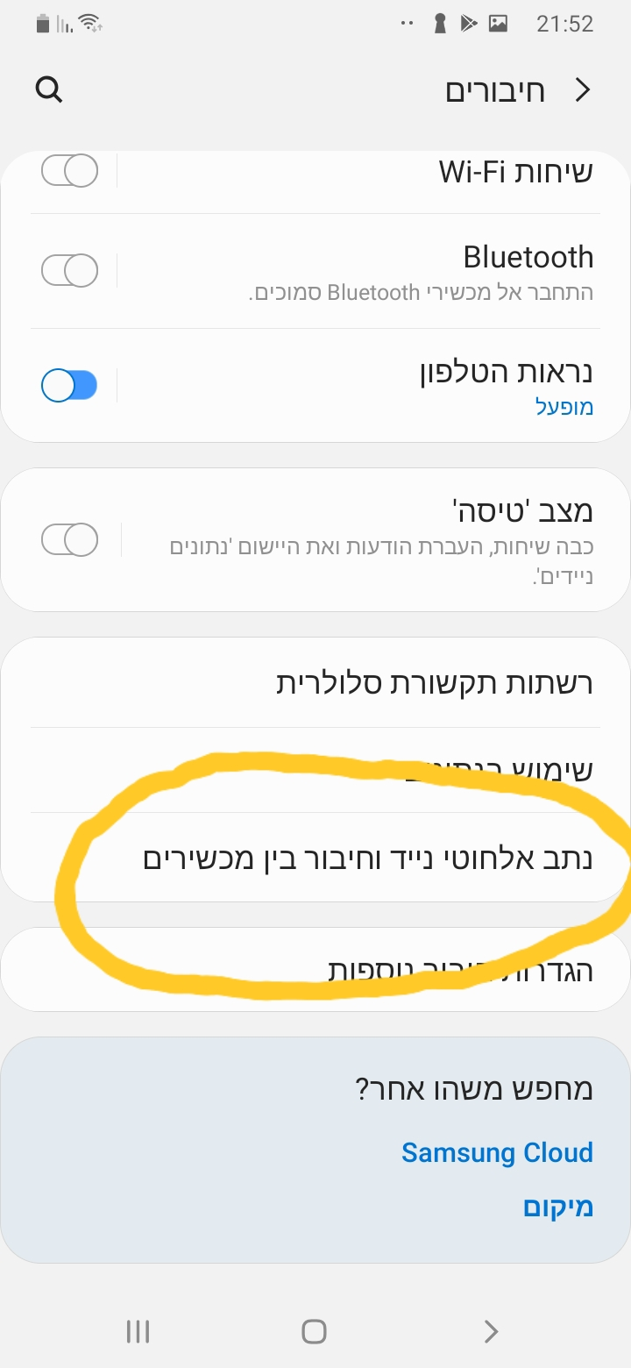
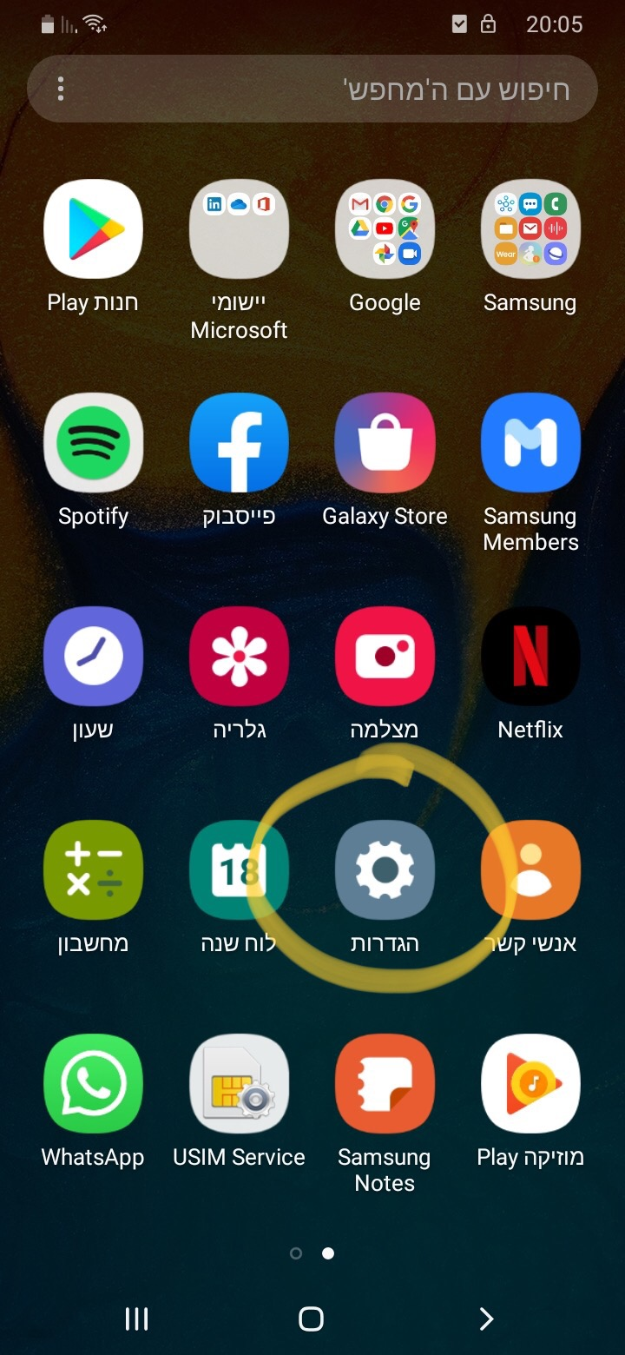
No mdns on Android so… (buy an iPhone ☺ or)

Slide 25

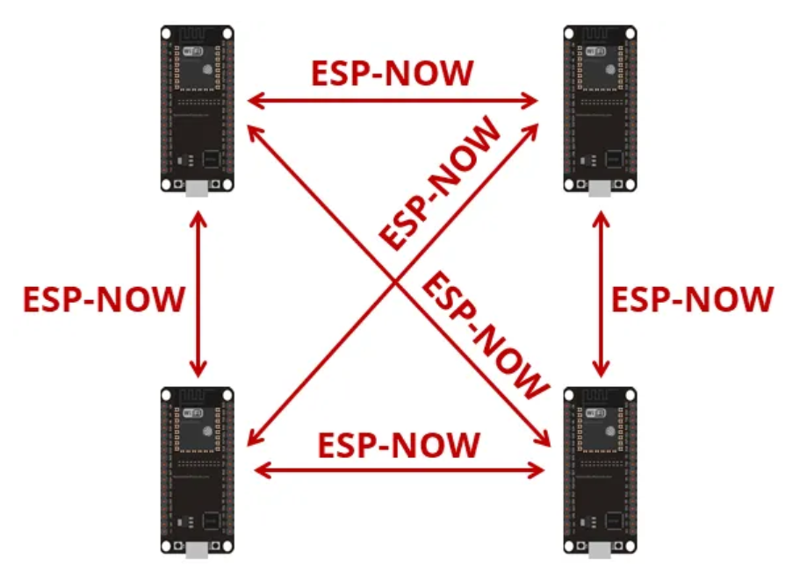
Protocol developed by Espressif
Enables multiple devices to communicate without using Wi-Fi
Low-power 2.4GHz wireless connectivity
Encrypted and unencrypted unicast communication
Up to 250-byte payload can be carried
10 encrypted peers at the most (STA mode), 6 for SoftAP or STA + SoftAP

Slide 26
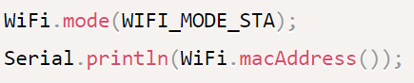
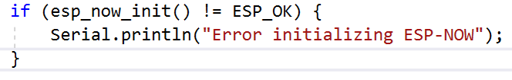
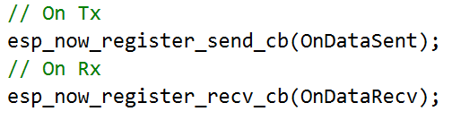
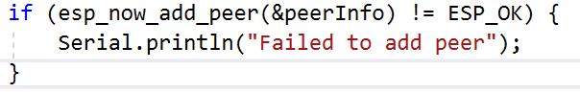
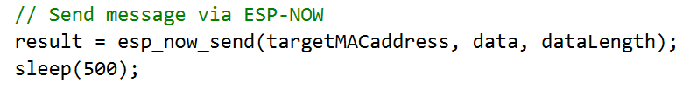
Esp-now
Works with MAC address
Need to know the our MAC and the Peer’s
Initialize the protocol
Register callback functions for send and receive
Register peers
Upon sending the send function will be called:
With status
With the MAC of the targeted peer
Upon receiving the receive function will be called:
With the MAC of the sender
With the received data

Slide 27
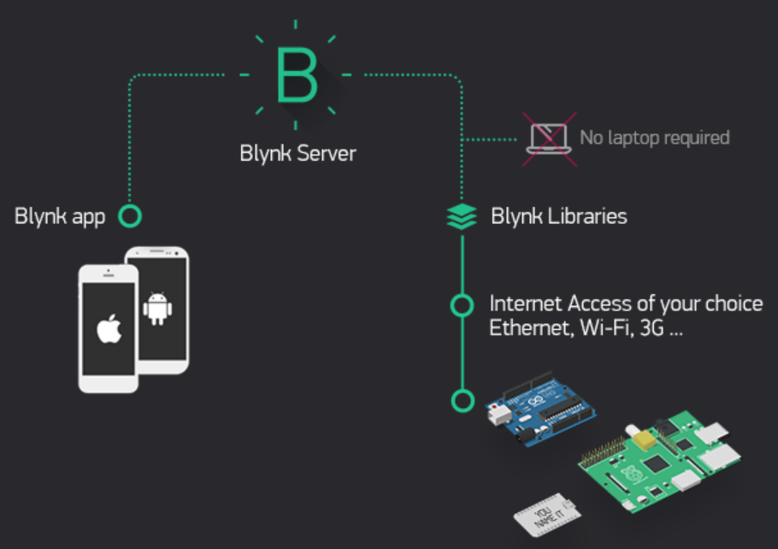
IOT – Controlling our ESP32 over the cloud
Using the ESP’s WIFI
We need to connect to a hotspot with internet access
We need a service provider to enable cloud activities such as
Control I/Os
Get and push data to our ESP
There are many cloud service providers out there
I prefer using Blynk (more on the next slide)

Slide 28
IOT – BLYNK
Works via application on a phone or tablet (No web or PC apps)
Can work via Wi-Fi or Bluetooth
The application is very easy to use and very powerful
Code is extremely simple to manipulate using a dedicated library
Has a code wizard generator on their website
Wi-Fi and Bluetooth code is the same, only small change in initialization
Automatic application sync for all used devices
Android supports widgets
We can use our own server!! (RPI4)
Blynk have a service to generate an application for us to be published on app store
Look at the course GIT for a user guide and a demo code

Slide 29

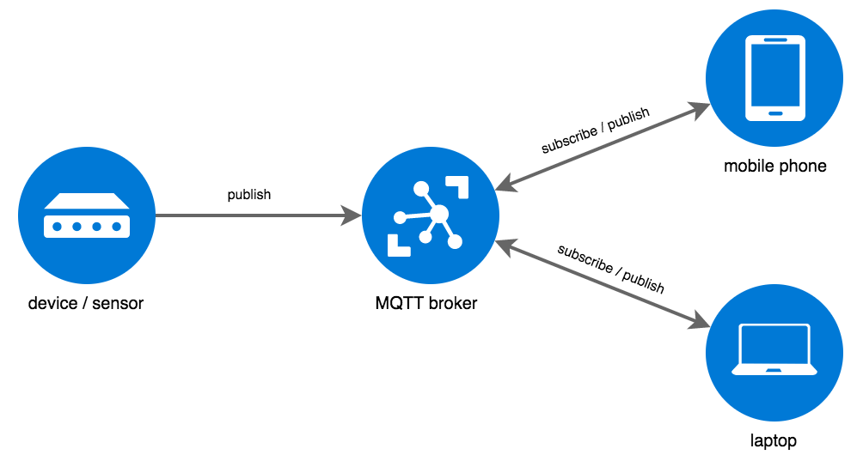
MQTT
Needs a broker (we can setup our own very cheap!)
ESP32 is the device
Works all over the world

Slide 30

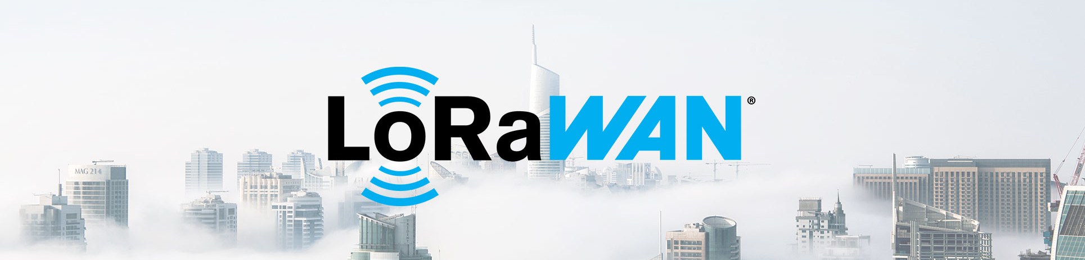
LoRa
Long range 433-966 MHz point to point communication
Up to 5KM
Uses unique address (65K)
SPI interface to ESP32

Slide 31

Multi Tasks
Tasks and Multi CPU
TaskHandle_t Task1;
bool virtualPin1 = true, virtualPin2 = true;
void Task1code(void * pvParameters)
{
while (1)
{
virtualPin1 = true;
delay(1000);
virtualPin1 = false;
delay(1000);
}
}
// In Setup
xTaskCreatePinnedToCore(
Task1code, /* Task function. */
"Task1", /* name of task. */
1000, /* Stack size of task */
NULL, /* parameter of the task */
5, /* priority of the task */
&Task1, /* Task handle to keep track of created task */
0); /* pin task to core 0 */

Slide 32

Queues
Queue
QueueHandle_t vidQueue;
void Task(void *arg)
{
while (1)
{
xQueueReceive(vidQueue, &param, portMAX_DELAY);
….Code will run if we get message on the queue
}
}
// Sender Code
xQueueSend(vidQueue, &param, portMAX_DELAY);
// In setup
vidQueue = xQueueCreate(1, sizeof(uint32_t*));

Slide 33

File System - SPIFFS
Part of the ESP32 flash memory (size can be setup)
Possible to load an image directly from SDK (from folder data)
void setup() { // Launch SPIFFS file system
if (!SPIFFS.begin())
{
Serial.println("An Error has occurred while mounting SPIFFS");
}
}
void loop() {
File file = SPIFFS.open("/TestFile.txt");
char buf[100];
int fileSize;
if (!file)
{
Serial.println("Failed to open file for reading");
while (1);
}
Serial.print("File size: ");
Serial.println(fileSize = file.size());
if (fileSize < 100)
{
file.readBytes(buf, fileSize);
for (size_t i = 0; i < fileSize; i++)
{
printf("%c", buf[i]);
}
printf("\n");
}
file.close();
while (1);}

Slide 34
File System – SD card over SPI
#include "FS.h"
#include "SD.h"
#include "PCF8574.h"
SPIClass SDspi(HSPI); // VSPI is used by LCD
bool SDmountOK;
PCF8574 pcf8574(0x21);
// the setup function runs once when you press reset or power the board
void setup() {
Serial.begin(115200);
pcf8574.begin();
pcf8574.pinMode(P0, OUTPUT); // SD CS
pcf8574.digitalWrite(P0, LOW); // Set SD card chip select to low (enabled)
SDspi.begin(15, 36, 13, -1);
if (!SD.begin(50, SDspi, 1000000, "/sd", 5))
{
printf("Failed to mount SD card!\n");
SDmountOK = false;
}
else
{
printf("SD card mounted on VSPI.\n");
SDmountOK = true;
}
}// the loop function runs over and over again until power down or reset
void loop() { if (SDmountOK)
{
listSDcardFiles("/");
}
while (1);}
FAT32 full support
Possible to load new code from SD!

Slide 35

OTA (Over the air update)
Possible to update the FW directly from
GIT
SD Card
Directly from a PC using Web Server code

Slide 36
Good to know
IOs
When using SPI RAM
DMA
You can expand the total malloc size to include the SRAM but the speed of SPI RAM allocated memory is much slower (use: heap_caps_malloc_extmem_enable(1024 * 1024 * N); N = number of MB needed)
Some IOs are used for sample @ reset, make sure to use them properly or your project might not work (info is specific to each member of the ESP32 family)
When WiFi is enabled analog inputs from channel 2 are not functional
S2\3 can perform DMA from SPI-RAM!
ESP32 has DMA (direct memory access) engines, they are implemented differently on S2\3
Don’t buy official ESP32 modules, look at AliExpress
M5 stack has very interesting modules
So as Lilygo
Visual studio can be used with Visual Micro plug-in (12$) for the best SDK experience out there!
There are lots of off the shelf modules in the market

